Slide 1


New York City 311 noise call analysis
Submitted to: Professor Walter McHugh
College of Professional Studies, Northeastern University
EAI 6120: AI Communication/ Visualization
By: Nilay Anand

Slide 2
Agenda
Analysis of Noise Complaints in New York City
Areas in NYC that need attention
Actions city can take to better manage the situation
Application of Machine Learning Models in city management

Slide 3
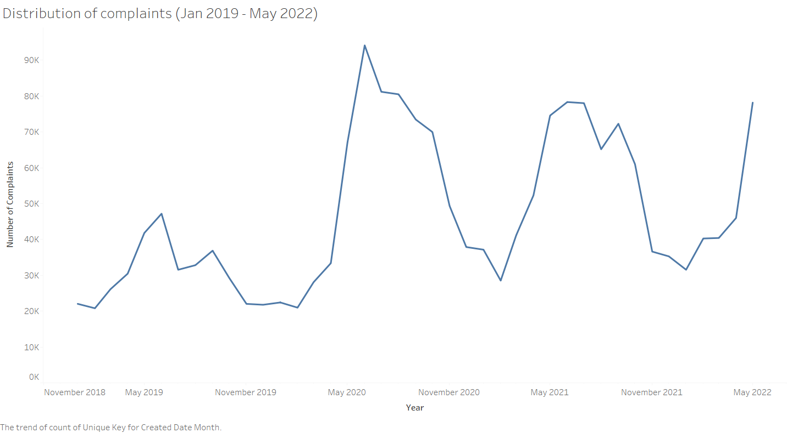

Slide 4
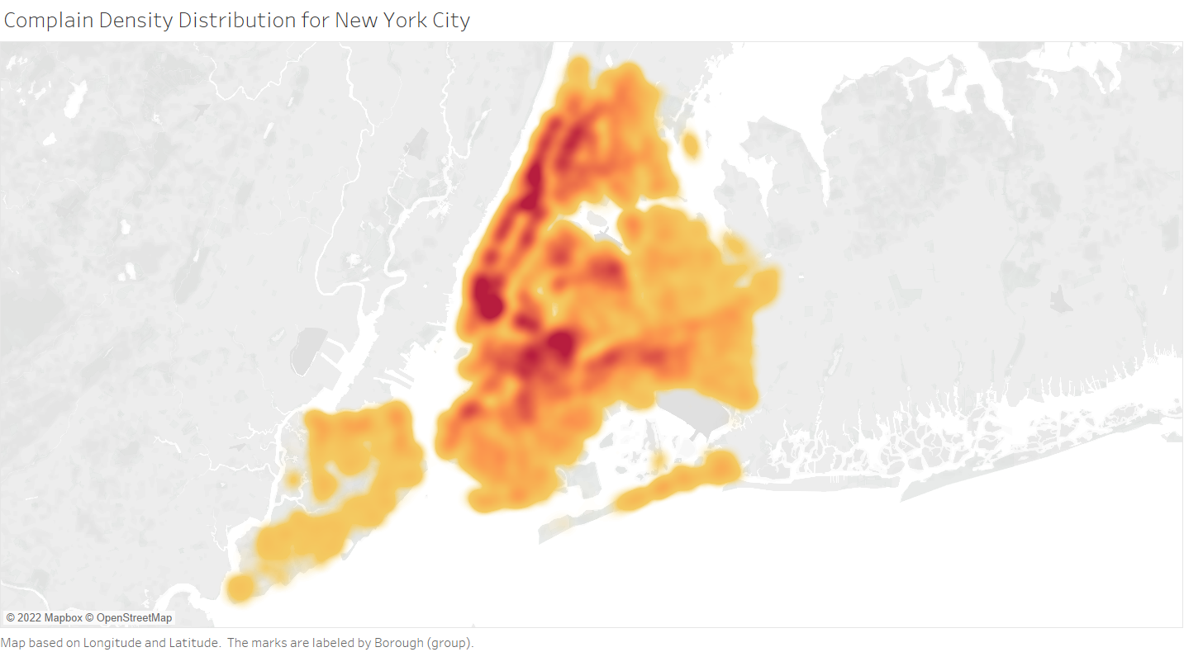

Slide 5
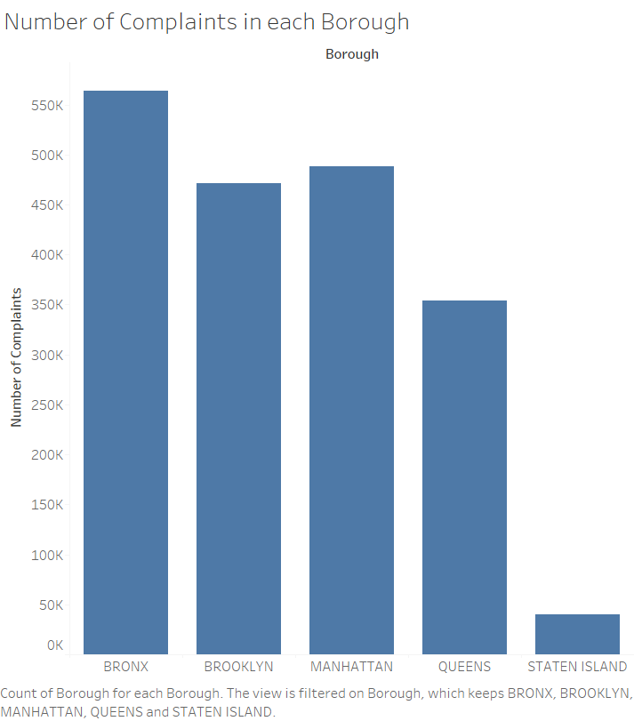
Manhattan has the most noise complaints, second only to Bronx

Slide 6
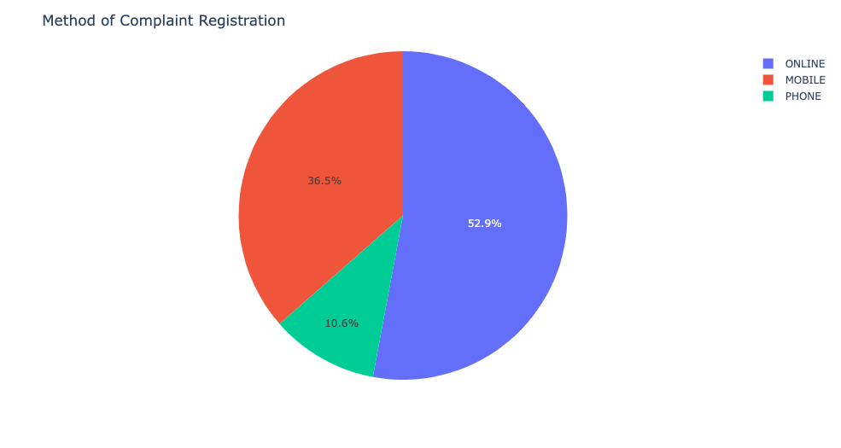

Slide 7
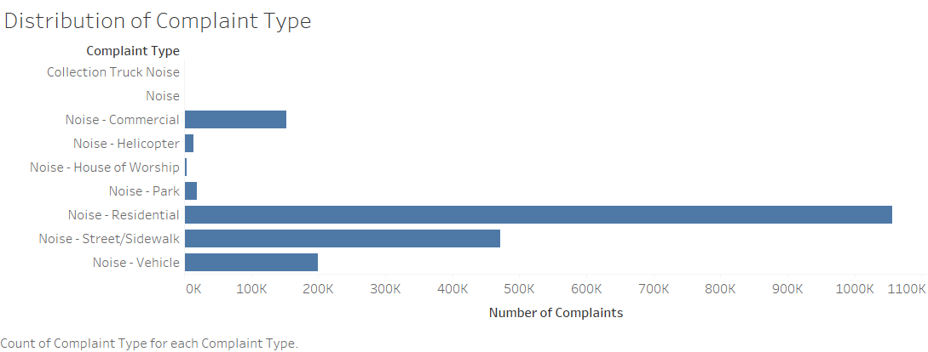
Noise has Multiple Types in NYC

Slide 8
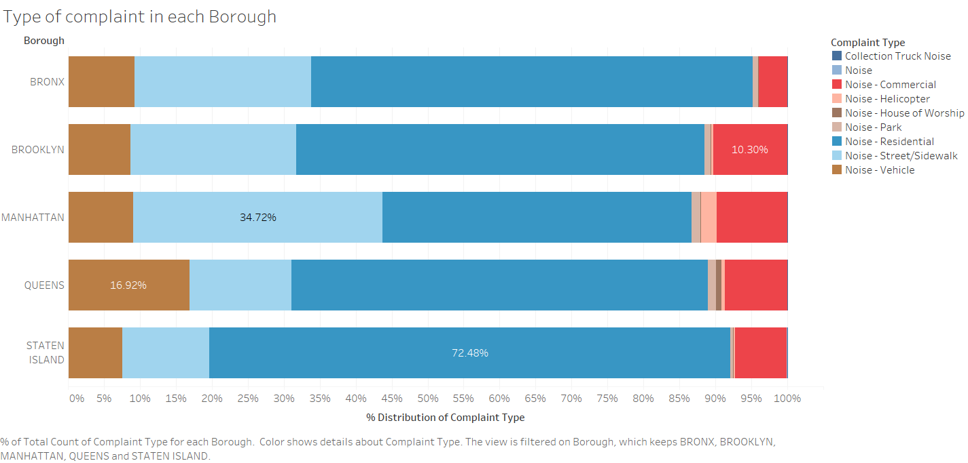
Let’s Break it Down
Residential Noise is the primary reason of annoyance in all Boroughs
Staten Island has the highest percentage of Residential Noise
Manhattan also has huge amount of Steet/Sidewalk noise

Slide 9
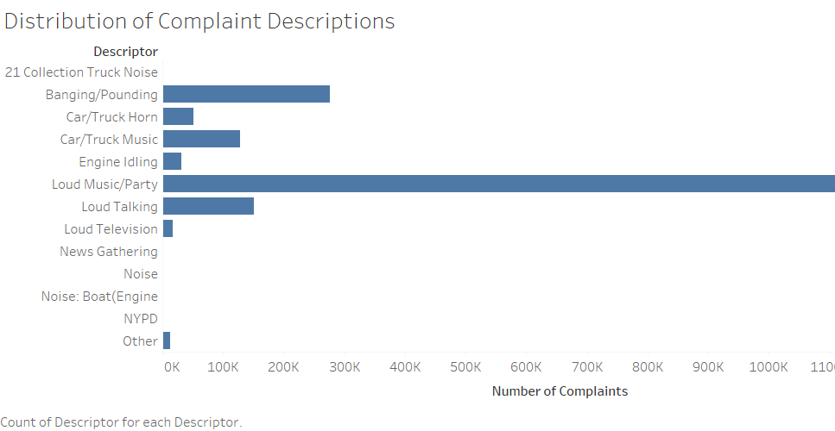
New York loves to Party!

Slide 10
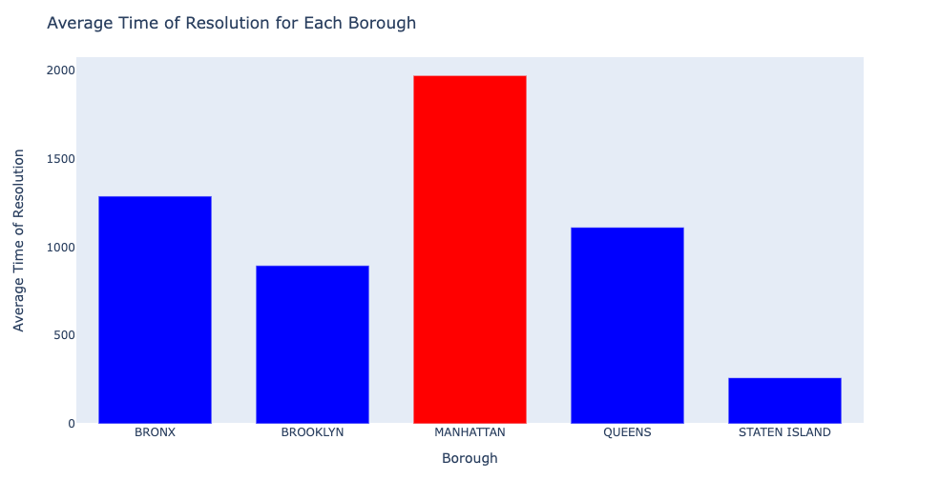
What is being done currently?

Slide 11
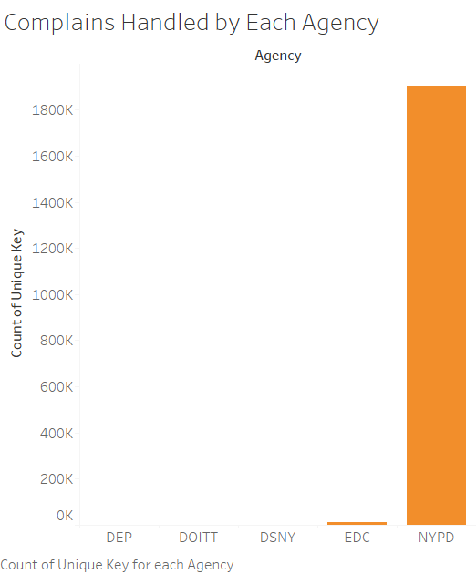
NYPD is on the case

Slide 12
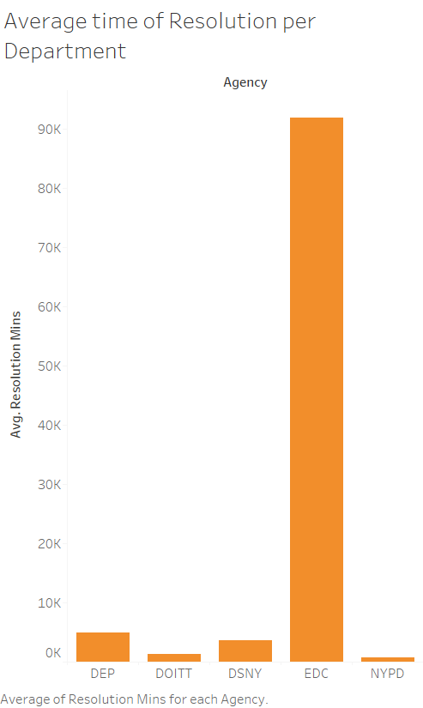
And they seem to be doing just fine

Slide 13
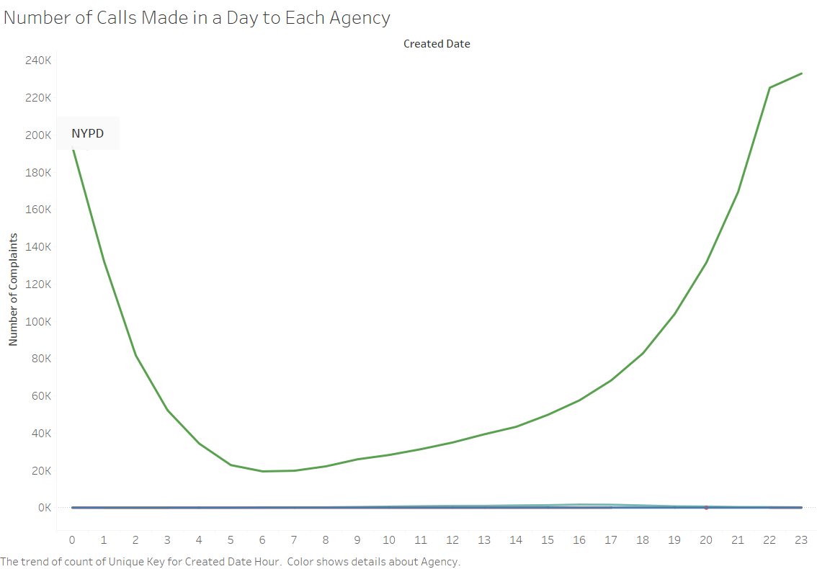
They are also kept busy at Night

Slide 14
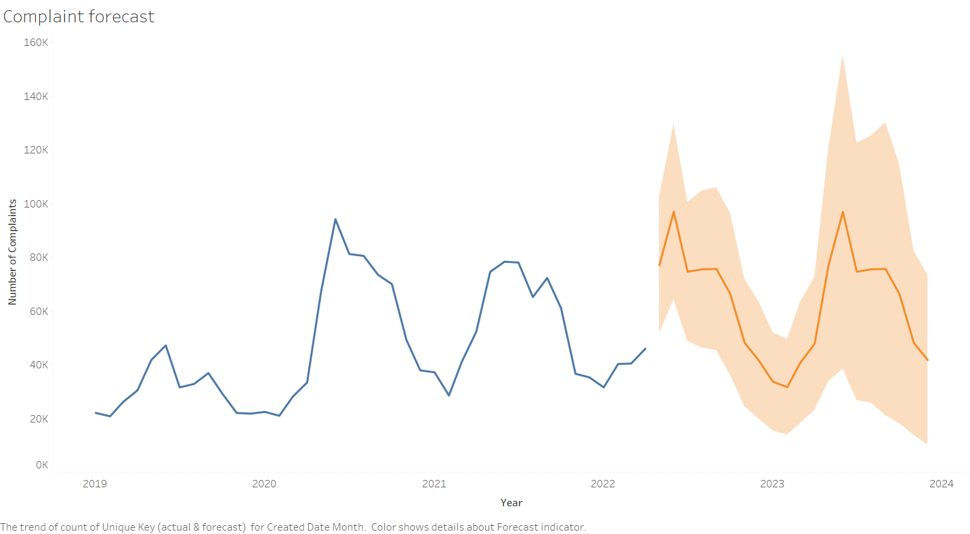
If this continues…

Slide 15
What can be done?
NYPD is great, other channels can be optimized
Since NYPD handles most complaints, employing machine learning models to predict incident and call volumes can further improve response times
Test setting noise restriction like limiting decibel levels for late night

